Slide 1
Finding Data On the web

Slide 2
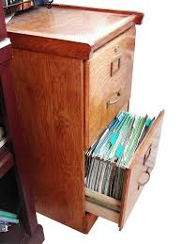
A very common data format …

Slide 3
Where is Data?
Data is Collected Every Time Something is:
Registered
Inspected
Purchased
Voted on
Surveyed

Slide 4
Finding Data on the Web:
Data Formats for Download
Portable Document Format (PDF): charts that contain data but are saved in a unified document with text
Excel file (xls): data is saved as a table readable by Microsoft Excel
Comma separated values (CSV): Plain text file with each data separated by a comma

Slide 5
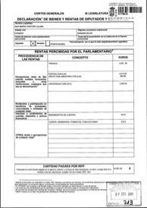
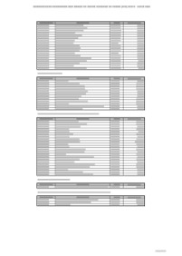
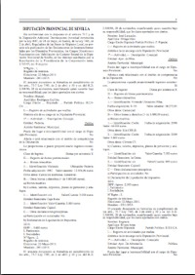
Understanding Data Formats
PDFs
Scanned Images (Unstructured, not searchable)
Computer-generated (searchable)
Tables (Structured, searchable)
Complex formats (Unstructured, searchable)

Slide 6
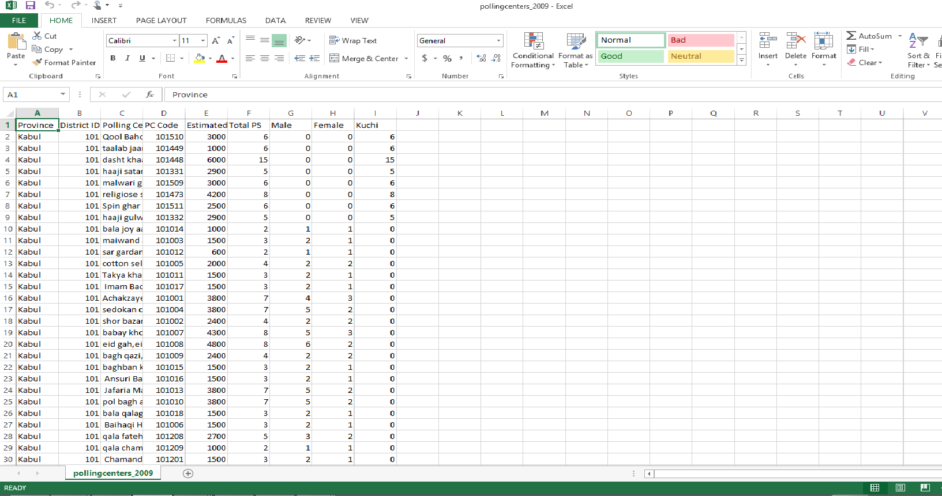
Understanding Data Formats: Machine Readable

Slide 7
Finding Data on the Web
Data Sources Online
Twitter!
Think tanks, NGOs, academics and government
Advanced Google searches
Exercise
Database searches
Summary & conclusions

Slide 8
Finding Data on the Web
Data tweets
#Afghanistan
#ddj
#datajournalism
#opendata
#dataviz

Slide 9
Finding Data on the Web
Data Sources Online
Twitter!
Think tanks, NGOs, academics and government
Advanced Google searches
Exercise
Database searches
Summary & conclusions

Slide 10
Data Sources: Theories to be Explored
Global and open data catalogs
World Health Organization
United Nations
Population Reference Bureau
UNICEF Data
The Guardian's world government data portal
Google's public data directory
The data hub
DBPedia Datasets
Factual
Free GIS data
List of open data resources
Energy data repositories
World Research Institute
Data wrangling
Quora thread: "Where can I find large datasets open to the public?"
Directory of APIs
Infochimps
Datamarket
Offshore Leaks
Investigative Dashboard
Open Corporates
Natural Earth data
UNEP Data
Transparency International Corruption Index
Land Ownership Database
Gapminder World

Slide 11
Data Sources: Theories to be explored
Afghanistan Data Sources
Central Statistics Office
International Security Assistance Force
Afghanistan Conflict Monitor
AfghanWire
The Afghanistan Analysts Network
Afghanistan Research and Evaluation Unit
International Crisis Group
Afghanistan Health Data
Ministry of Public Health
Health Policy Project
http://www.afga.org.af/
Afghanistan Private Hospitals Association (APHA)
Afghan National Medicines Services Organization (ANMSO)
Afghan Midwifery Association (AMA)
Afghan Social Marketing Organization (ASMO)
Futures Group
HIV/AIDS Coordination Committee of Afghanistan (HACCA) Secretariat
Organization of Afghan Midwives (OAM)

Slide 12
Finding Data on the Web
Data Sources Online
Twitter!
Think tanks, NGOs, academics and government
Advanced Google searches
Exercise
Database searches
Summary & conclusions

Slide 13
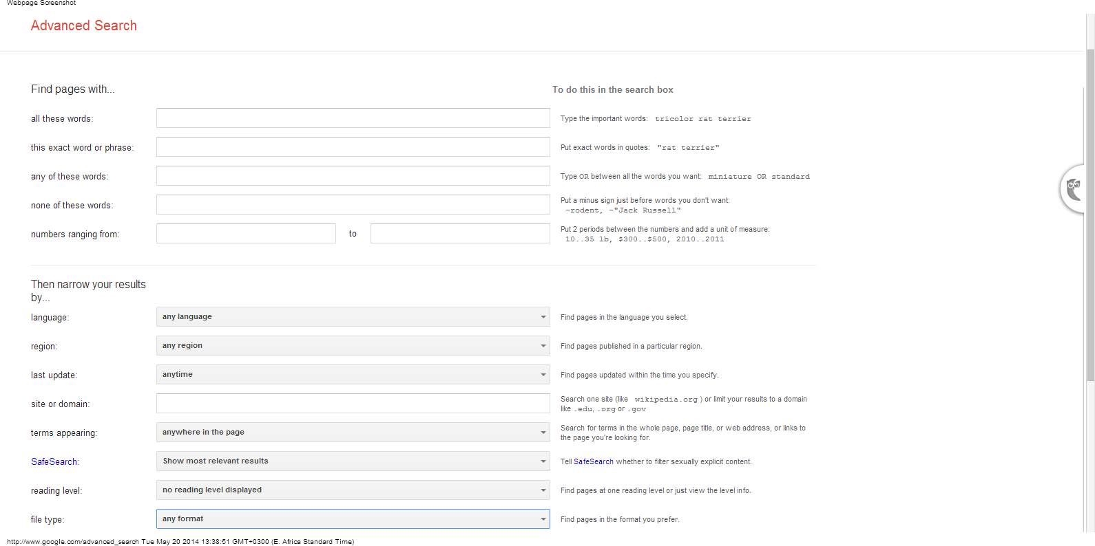
Finding Data on the Web:
Google Advanced Searches

Slide 14
Finding Data on the Web
Data Sources Online
Twitter!
Think tanks, NGOs, academics and government
Advanced Google Searches
Exercise
Database searches
Summary & Conclusions

Slide 15
Finding Data: Advanced Google Searches Shortcuts
All these words is a regular search.
Shortcut: Type in all the words you want to find.
This exact word or phrase specifies the order the words should appear
Shortcut: Use quotes to search for phrases “Central Statistics Organization Islamic Republic of Afghanistan”

Slide 16
Exercise
1. Use all these words to search for content about malnutrition in your province.
All these words is a regular search.
Shortcut: Type in all the words you want to find.
2. Use this exact word or phrase to find information about the Ministry of Rural Rehabilitation and Development.
This exact word or phrase specifies the order the words should appear
Shortcut: Use quotes to search for phrases “Central Statistics Organization Islamic Republic of Afghanistan”

Slide 17
Finding Data: Advanced Google Searches Shortcuts
Any of these words use related terms for the same search
Shortcut:
Type OR to find variations of the same search: Afghanistan elections OR voting OR polls
None of these words will filter out sites with words that you specify
Shortcut: Type - sign right before the word: Afghanistan elections -violence

Slide 18
Exercise
1. Use any of these words to find content about malnutrition in your region.
Any of these words use related terms for the same search
Shortcut: Type OR to find variations of the same search: Afghanistan elections OR voting OR polls
2. Use none of these words to find information about malnutrition not from 2012.
None of these words will filter out sites with words that you specify
Shortcut: Type - sign right before the word: Afghanistan elections -violence

Slide 19
Finding Data: Advanced Google Searches Shortcuts
Language: specify the language of results
Region: limit to only Afghan websites
Last Update: limit to recent content

Slide 20
Exercise
Find content about Ebola only in French.
Language: specify the language of results
2. Find content about Ebola only from Afghan websites
Region: limit to only Afghan websites
3. Find content about Ebola published in the last week.
Last Update: limit to recent content

Slide 21
Finding Data: Advanced Google Searches Shortcuts
Site or domain: Narrow search to specific website:
Shortcut
site:url Example site:http://www.who.int/
The website address has to be EXACT
WRONG: site: MinistryofHealth.go.af
RIGHT: site:http://www.moph.gov.af/
Open a new tab, use Google to search for the correct address, then copy and paste the address into your search tab.

Slide 22
Finding Data: Advanced Google Searches Shortcuts
Filetype: search only for a specific extension
Shortcut
Filetype:[extension] xls xlsx pdf csv doc
Example: filetype:pdf
RIGHT:
Afghanistan maternal health filetype:xls
site:www.irinnews.org/ filetype:pdf afghanistan malaria
WRONG:
filetype:education. Filetype:Word.

Slide 23
Exercise
1. Search the Ministry of Health website for Excel files
Site or domain: Narrow search to specific website:
Shortcut
site:url Example site:http://cso.gov.af/ filetype:xls
2. Search for PDFs about maternal health in Afghanistan
Filetype: search only for a specific extension
Shortcut
filetype: Filetype:[extension]
Example: filetype:xls

Slide 24
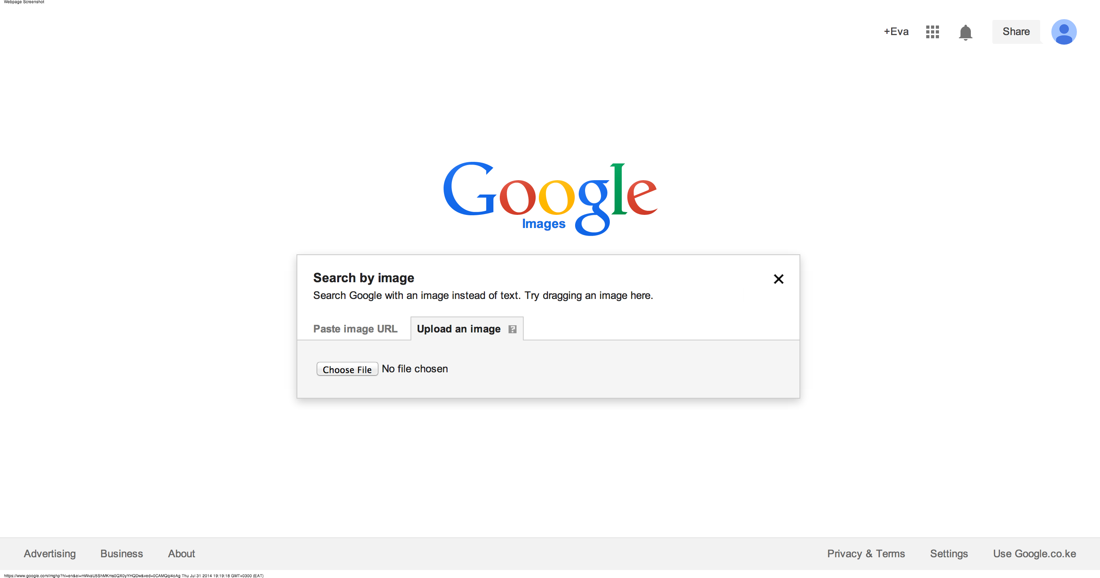
Finding Data: Advanced Google Searches Shortcuts
Search by image: go to Google Image Search and add your photo, either by URL, uploading or dragging-and-dropping from your computer.

Slide 25
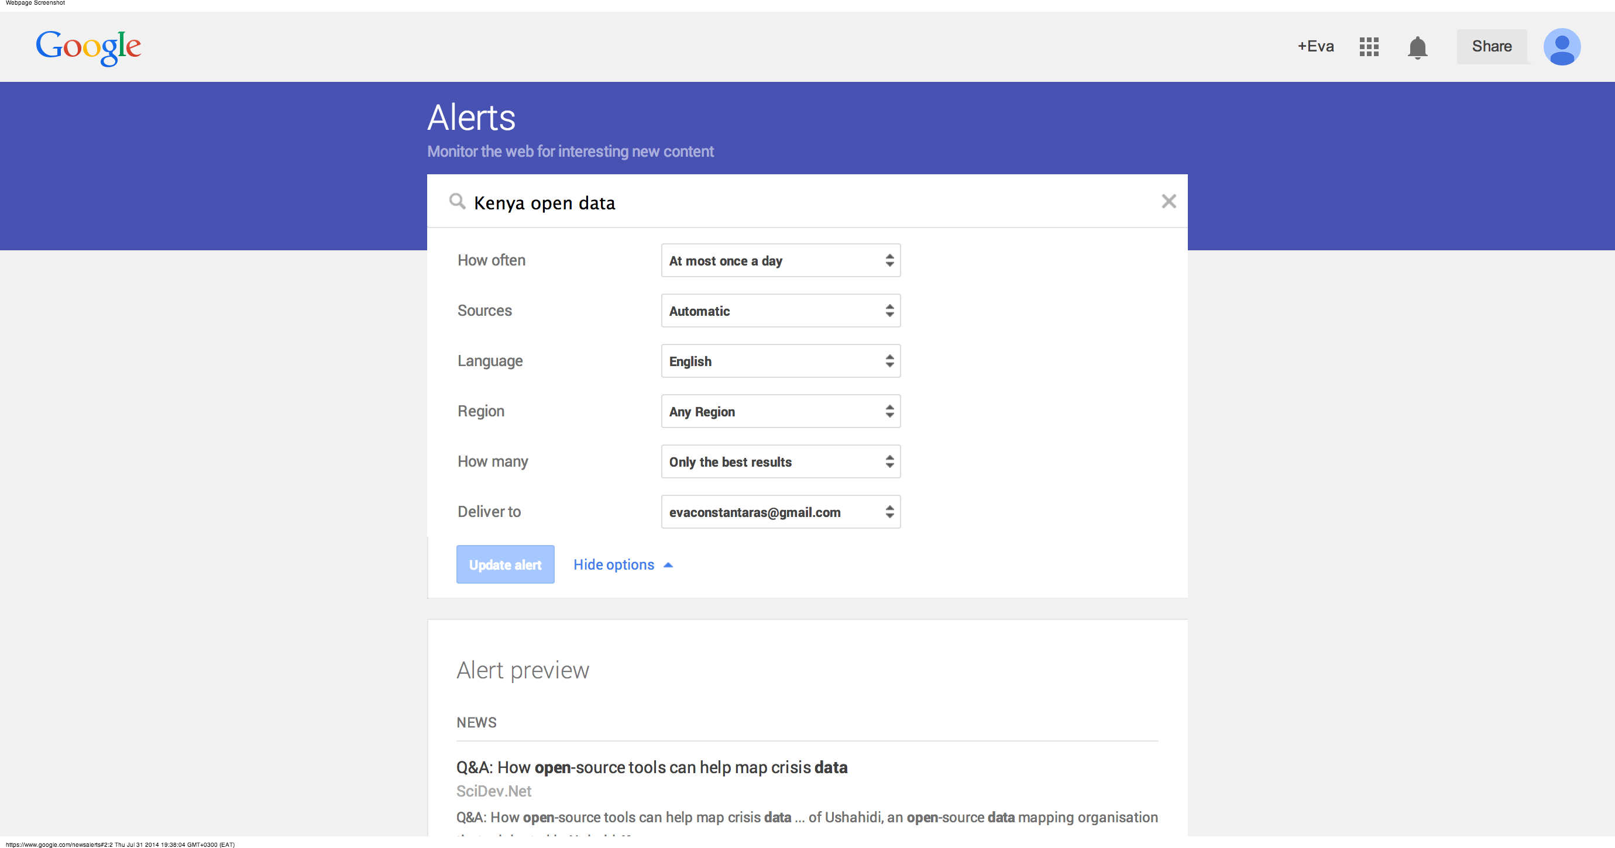
Finding Data: Advanced Google Searches Shortcuts
Google News Alerts: get notified about your beat

Slide 26
Finding Data on the Web
Get an alert every time a webpage is updated with new data:
www.changedetection.com/
Update Scanner

Slide 27
Finding Data on the Web
Data Sources Online
Twitter!
Think tanks, NGOs, academics and government
Advanced Google Searches
Exercise
Database searches
Summary & Conclusions

Slide 28
Finding Data on the Web: Exercise
Get into your groups:
Search for data about child health
Search for data about maternal health
Search for data about infectious disease

Slide 29
Finding Data on the Web
Data Sources Online
Twitter!
Think tanks, NGOs, academics and government
Advanced Google Searches
Exercise
Database searches
Summary & Conclusions

Slide 30
World Bank Data Bank
Open http://data.worldbank.org/
Under “EXPLORE DATABASES,” select “Health Nutrition and Population Statistics”
Select Afghanistan
Click on “Series”
The topics are listed on the left. Select a topic that interests you.
Select the indicators by checking the ones you want.
Click on “Years” and check years.
Then click on Table on the top right corner when your selection is ready.

Slide 31
Finding Data: No Excuses!
“We don’t have that data on a computer.”
High fees
Delay tactics
“Your request was unclear.”
Sending the wrong data
“Our database is too complicated to give you access.”
“Our database software is proprietary.”
“That information is protected by privacy law.”

Slide 32
Finding Data on the Web
Data Sources Online
Twitter!
Think tanks, NGOs, academics and government
Advanced Google Searches
Exercise
Database searches
Summary & Conclusions

Slide 33
Summary & Resources
Data is available in many different formats and almost always you will need to convert data to an Excel or csv file.
Every day, more data is available online and accessible through searches
If you can’t find it online, don’t give up!

